Slide 1
The Impact of Artificial Intelligence on Healthcare
Nicky HEKSTER
COCIR Lead member in Digital Health and EMEA Technical Lead at IBM Watson Health

Slide 2
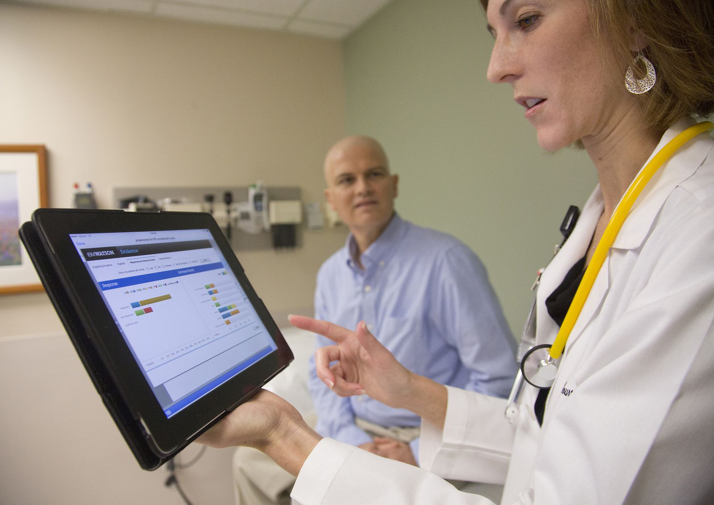
AI in Healthcare and Life Sciences coming of age
For the professional
Oncology
Radiology
Cardiology
Genomics
For the patient
Diabetes
COPD, Asthma
Triaging through apps and bots
For industry and research
Drug Discovery
Patient Safety
Clinical Trials

Slide 3
Usage, Evidence and Transparency
AI is to strengthen and expand the cognitive ability and expertise of a human being: augmented intelligence – man and machine – not replacing doctors.
Concordance studies are inherent to machine learning.
No black-box society: we should be perfectly clear on what is happening with (consented) data and algorithms – usage, ingestion, training, ownership.
We need a thorough discussion on the ethical and legal side of the technology.

Slide 4
Challenges
The younger Y-generation of healthcare professionals must be made aware – a need for eHealth in the current curricula.
  Healthcare and Life Sciences professionals and researchers who use AI will replace those who don’t.
We need clinical data scientists
We need data across healthcare institutes, regions, countries.
  Patients, populations, …
We need leadership to impose innovation and data stewardship.

Slide 5
Thank you for your attention!
www.cocir.org

